Slide 1
KFC APP

Slide 2
INTRODUCTION
Introducing KFC APP, a restaurant committed to addressing SDG 2: Zero Hunger. My project is dedicated to combating food insecurity, ensuring everyone has access to nutritious meals. Through innovative approaches, KFC aims to contribute significantly to the global effort of eradicating hunger, one delicious dish at a time.

Slide 3
DEVELOPMENT OF THE APP
As a team, we all contributed to the development of the project, the documentation, the prototype of the project, the front end and back end of it.
Tools we used as a group;
VS code editor – to make the code for the project where by we used four programming languages e.g. CSS, JavaScript, react js and html as we were interacting with this text editor.
Material ui – we installed it in vs code to create a robust design in the different pages of our project, ranging from buttons, icons among others.
Browser e.g. Microsoft edge – this helped us in the display of our program output and importation of some images that we used in the project and also its prototype.
Figma – we used this fancy platform to develop the prototype of our project
GitHub - We used it as a platform to collaborate as a team through our group repository

Slide 4
RESEARCH FROM THE COMMUNITY.
As a team, we decided to base our research on the project development from Ebenezer Restaurant. This research helped us know the considerations we should undertake so as to achieve our sustainable development goal ii “zero hunger”.
After a thorough engagement with the manager, he was amazed by the project since it was aimed at tackling a matter of national importance. Ebenezer as an enterprise are looking forward to taking a step forward and adopting the online market platform and improving on their quality of service though implementation could be difficult since it attracts overhead expenses like heavy taxes from the government.

Slide 5
PLAN AND PROTOTYPING FOR THE PROJECT.
Taste-pal restaurant Uganda was structured with fundamental features and functions like user authentication, menu display, order placement and tracking, reservations, responsive design and many other user interactive privileges.
We designed the prototype using figma, the prototype displays the front face of each of the mentioned features and responsive navigation bars and buttons in the web application

Slide 6
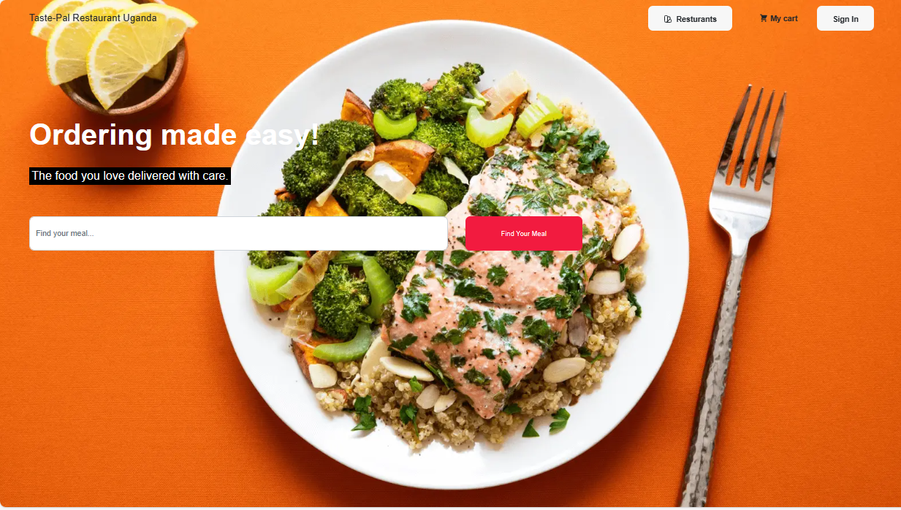
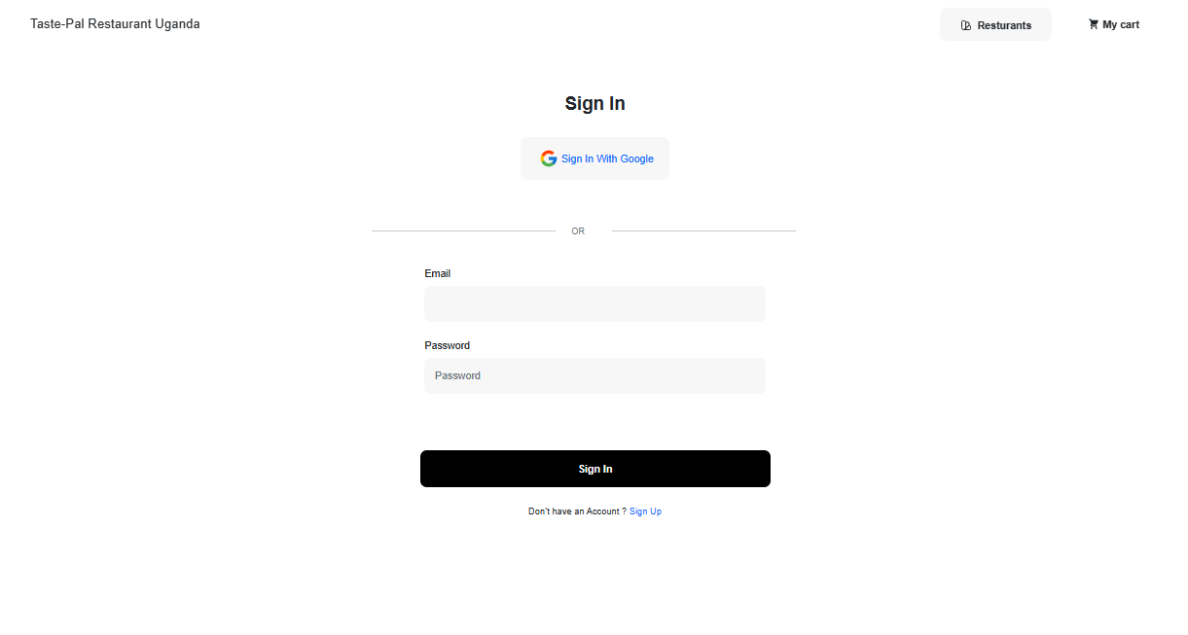
PROJECT SCREENSHOOTS
Home Page Login Page

Slide 7
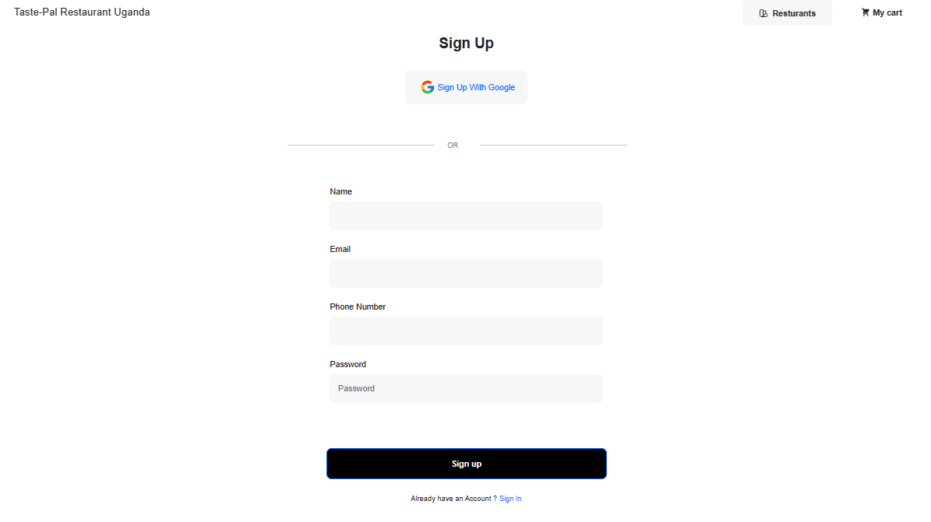
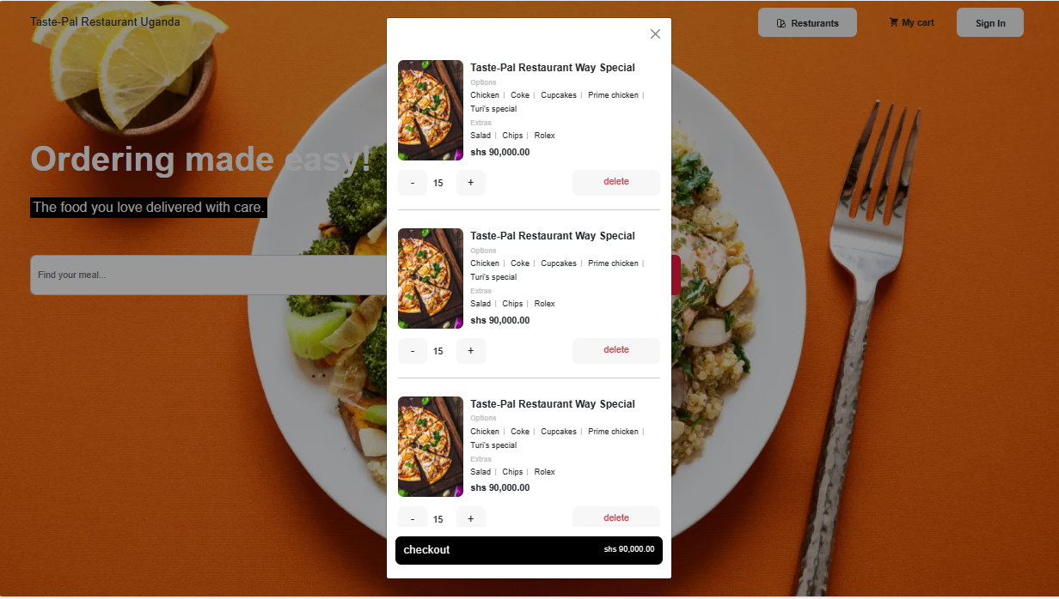
PROJECT SCREENSHOOTS…
Sign Up Page Cart

Slide 8
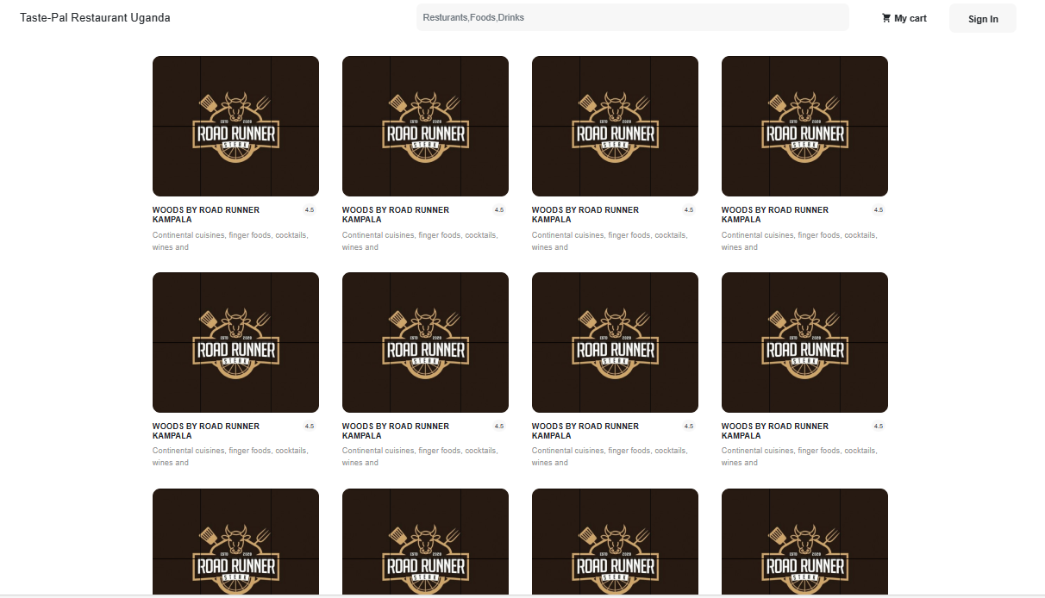
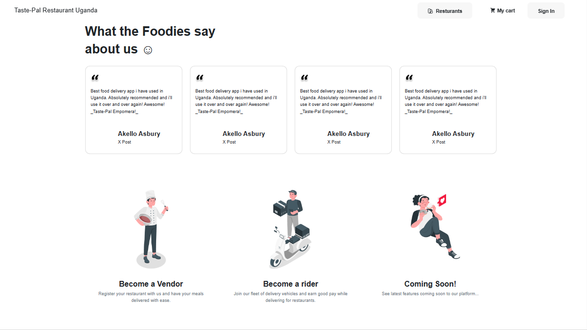
PROJECT SCREENSHOOTS….
Restaurants Other Features

